Slide 1

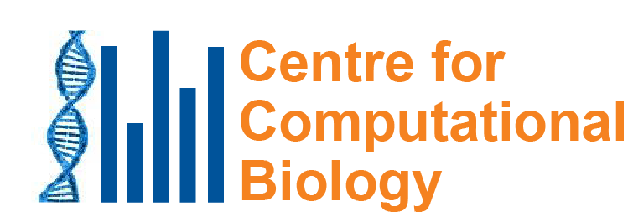
Mutational signatures: What caused the mutations in these cancers? Why do we care?
Steven G Rozen
steverozen@gmail.com
Duke-NUS Medical School, Singapore
InCoB 2020
19th International Conference on Bioinformatics
Virtual meeting
2020 Nov 28 (35 min)
Notes:
25 minute talk

Slide 2
Outline
What are mutational signatures and what are they good for?
Computational analysis of mutational signatures – state of the art
Important unsolved problems in mutational signature analysis
Summary

Slide 3
Outline
What are mutational signatures and what are they good for?
Computational analysis of mutational signatures – state of the art
Important unsolved problems in mutational signature analysis
Summary

Slide 4
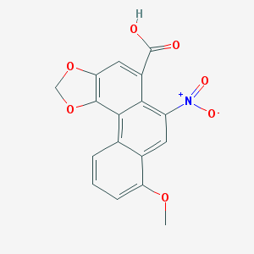
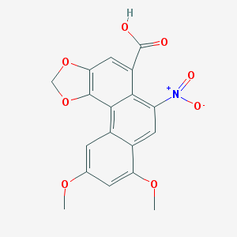
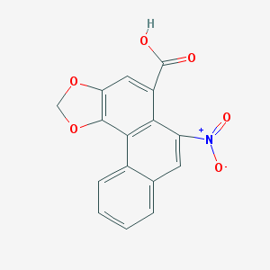
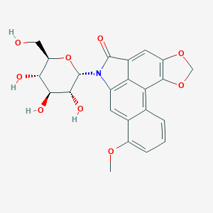
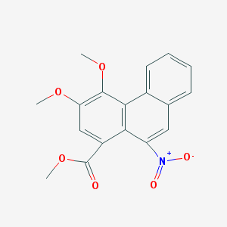
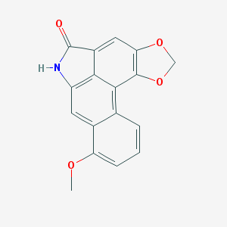
Aristolochic acids and relatives “AA”
Aristolochic acid I
Aristolochic acid II
Aristolochic acid IV
Aristolactam I, proximal mutagen
Aristolactam-N-beta-D-glycoside
Ariskanin A
We will call them all “AA”
Aristolochic acids (AAI – most studied, also AAII, AAIV, in many 关木通)

Slide 5
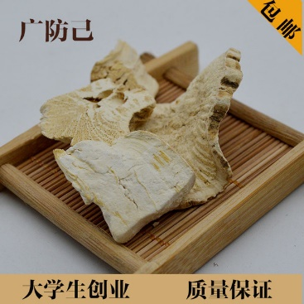
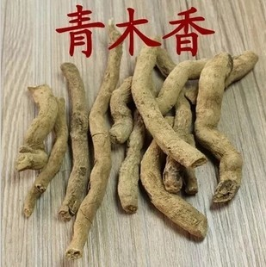
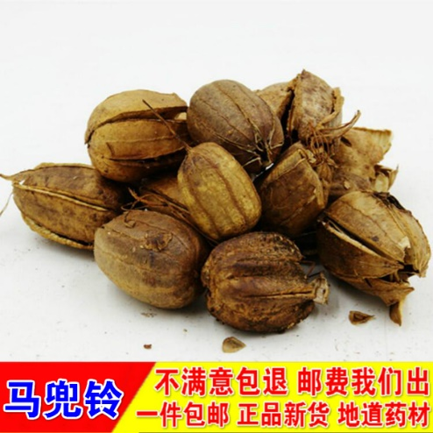
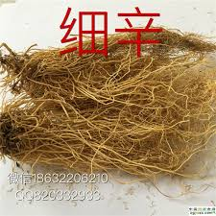
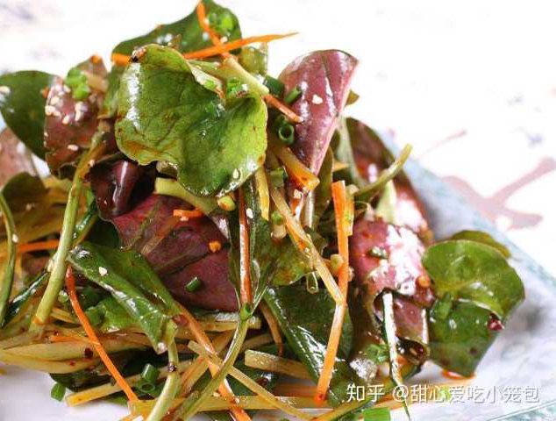
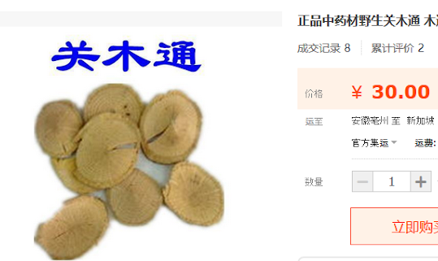
Plants with AA widely used as herbal medicine
(Occurs naturally in these plants)
Plants in Aristolochia and Asarum groups (genera), and perhaps other groups
鱼腥草

Slide 6
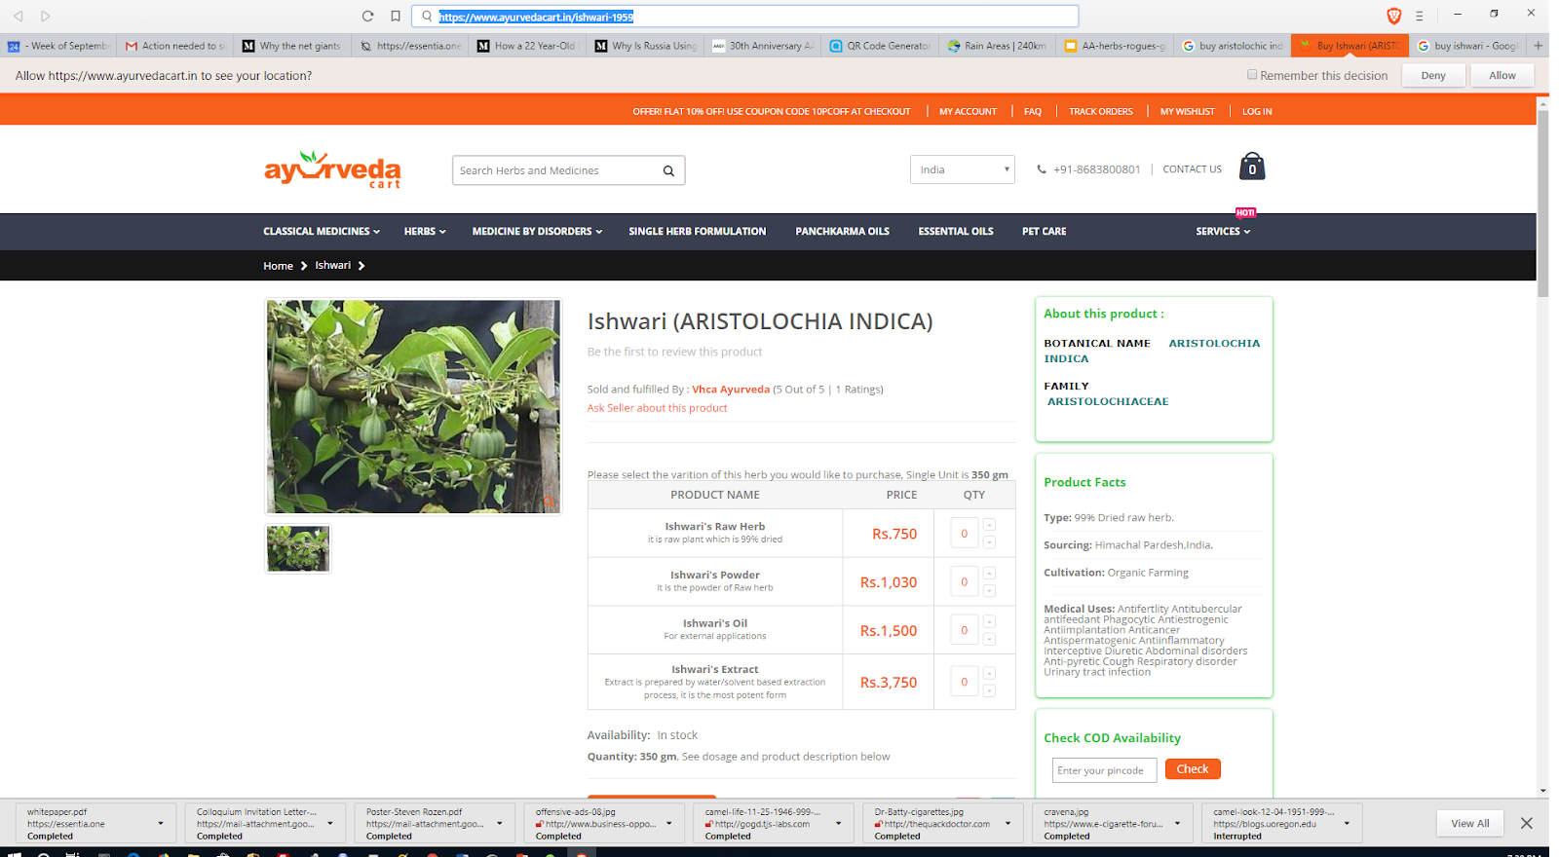
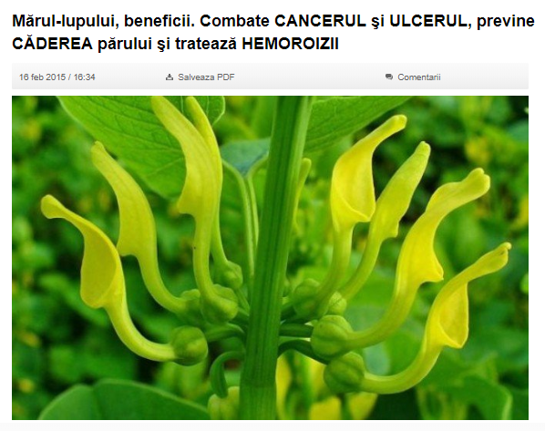
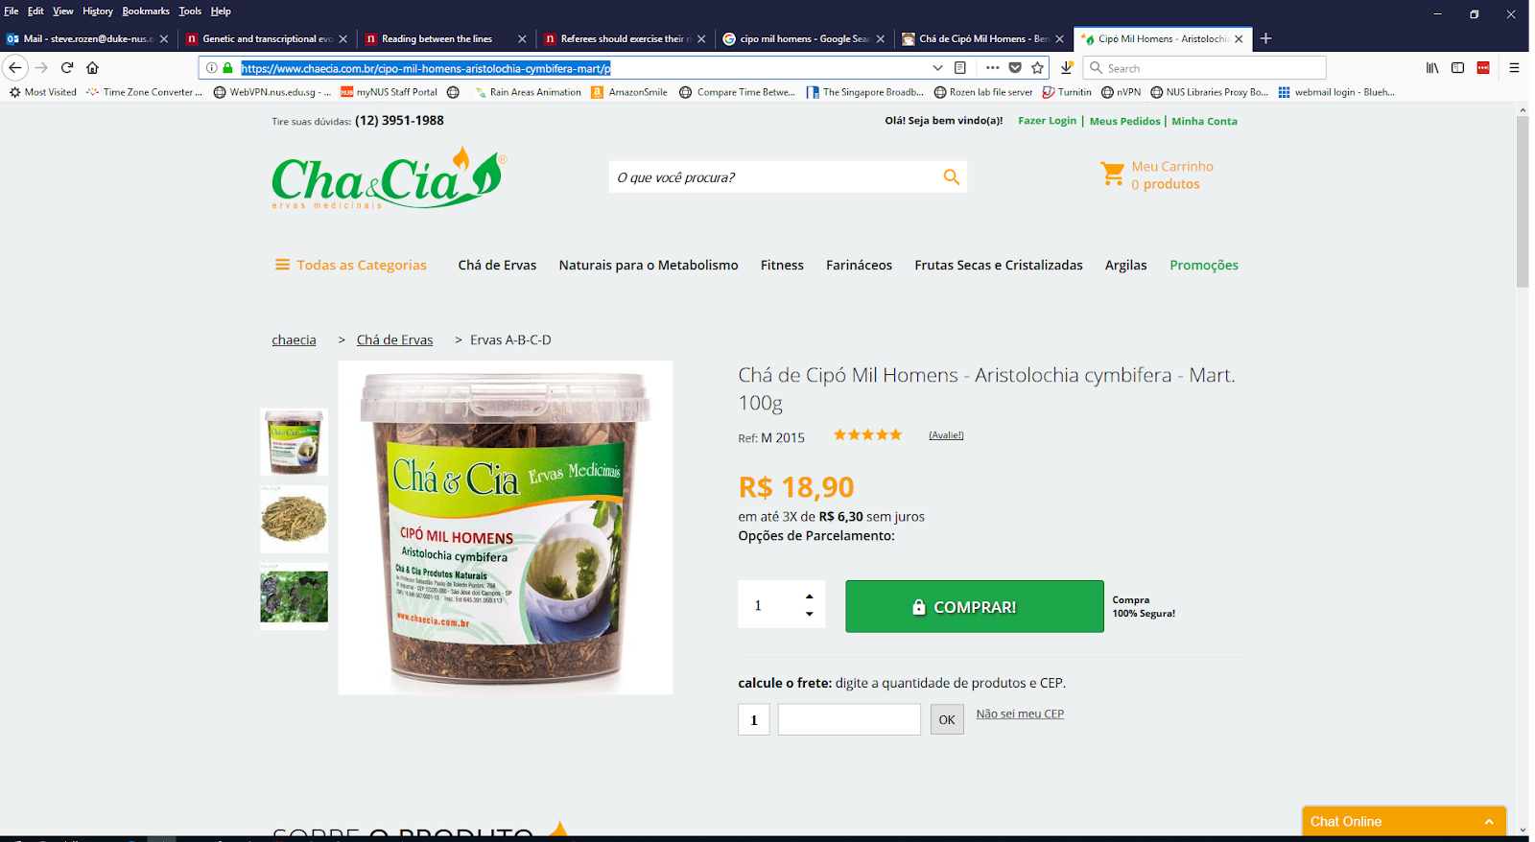
Not just Chinese herbal medicine
Romania
India
Aristolochia indica
Brazil
Aristolochia clematitis
Combats cancer, ulcers, prevents hair loss and hemorrhoids
Aristolochia cymbifera

Slide 7
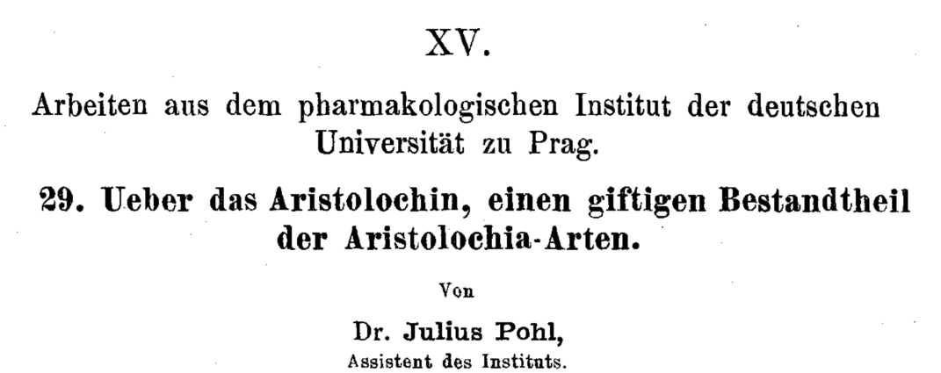
AA: well-known nephrotoxins
1891

Slide 8
1990s: AA emerges as a human health problem
~100 young women with end stage kidney disease
Single weight-loss clinic in Europe
汉防己, hàn fáng jǐ replaced by 广防己, guǎng fáng jǐ
Notes:
Dose: (Cosyns 2003; Nortier et al. 2000)
Adducts: Nortier et al., 2000

Slide 9
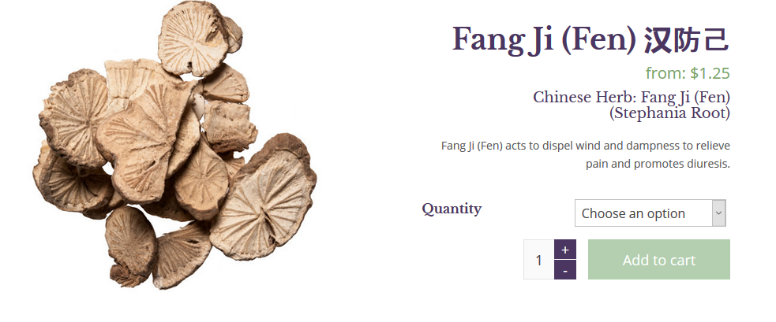
漢防己 / 汉防己, hàn fáng jǐ (genus Stephania – no AA)

Slide 10

廣防己/广防己, guǎng fáng jǐ (genus Aristolochia – has AA)
Notes:
Total of 0.5 g over average of 13 months
AA adducts

Slide 11
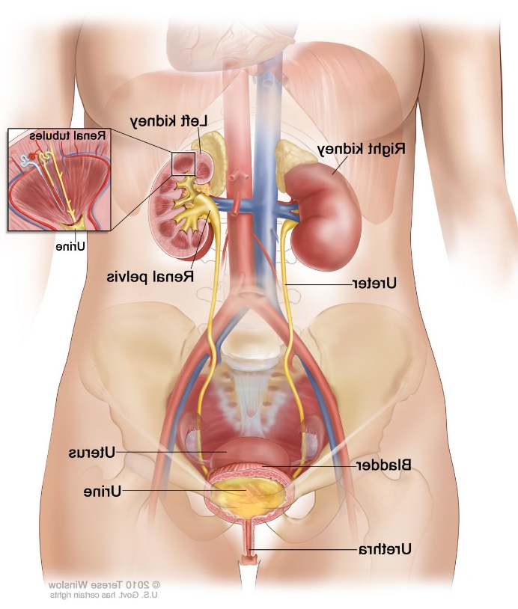
Many of the AA-kidney-failure victims developed upper tract urothelial cancer
Urothelial cancer in ureter
(tube that drains kidney)
(Nortier et al., 2000, NEJM)

Slide 12
Quick review: somatic mutations
Every time our cells divide, mutations arise
Mutations not present in the fertilized egg are somatic mutations
Our focus will be somatic mutations

Slide 13
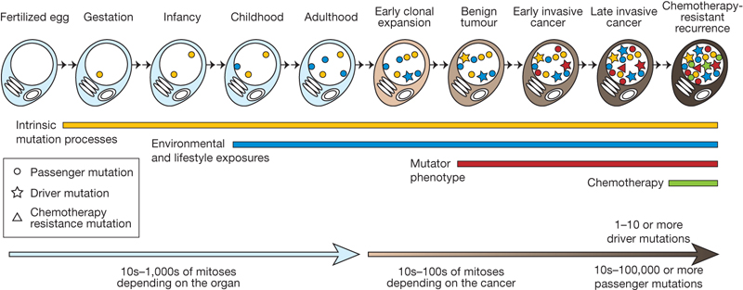
We detect somatic mutations by DNA sequencing normal cells and tumour cells
Normal
Normal
…ACGTCCTAGTCAAAATCGAGCC…

Slide 14
We detect somatic mutations by DNA sequencing normal cells and tumour cells
Normal
Tumour
…ACGTCCTAGTCAAAATCGAGCC…
…ACGTCCTAGTCTAAATCGAGCC…

Slide 15
We detect somatic mutations by DNA sequencing normal cells and tumour cells
We look for the variants found only in the tumor
Normal
Tumour
…ACGTCCTAGTCAAAATCGAGCC…
…ACGTCCTAGTCTAAATCGAGCC…
Somatic mutation from A > T
CAA > CTA trinucleotide context: information in neighboring bases

Slide 16
We look at all mutations (most are not causing the cancer; they are innocent bystanders)
We want to know: what mutated (changed) the DNA?
?

Slide 17
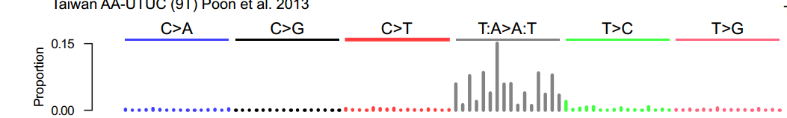
Mutational signature in an AA-exposed upper tract urothelial carcinoma
More
mutations
Each bar represents the total number of single nucleotide substitutions in a particular trinucleotide context
Highest bar represents the number of CAG to CTG mutations across the entire genome
The higher the bar, the more CAG to CTG mutations
Poon et al, Science Translational Medicine, 2013

Slide 18
Mutational signature in an AA-exposed upper tract urothelial carcinoma
More
mutations
AAG > ATG mutations
Not as many
Highest bar represents the number of CAG to CTG mutations across the entire genome
The higher the bar, the more CAG to CTG mutations
Mutations from C to A, C to G, C to T
Almost none
Poon et al, Science Translational Medicine, 2013

Slide 19
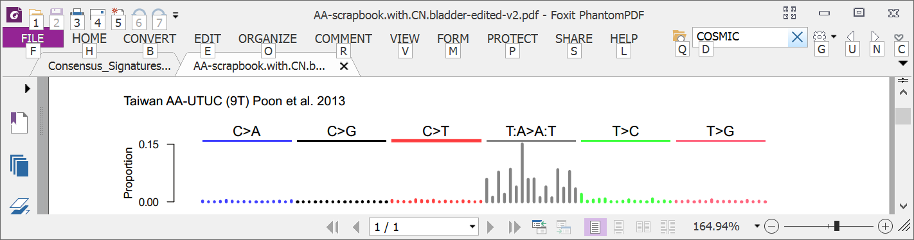
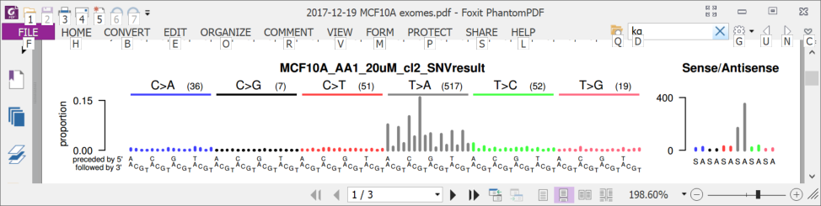
6 years ago (2013): AA in upper tract urothelial cancer and cell lines
Upper tract urothelial
AA exposed cell line
Poon et al., 2013, Hoang et al. 2013

Slide 20
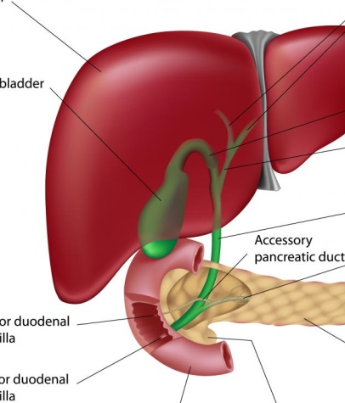
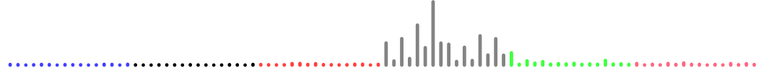
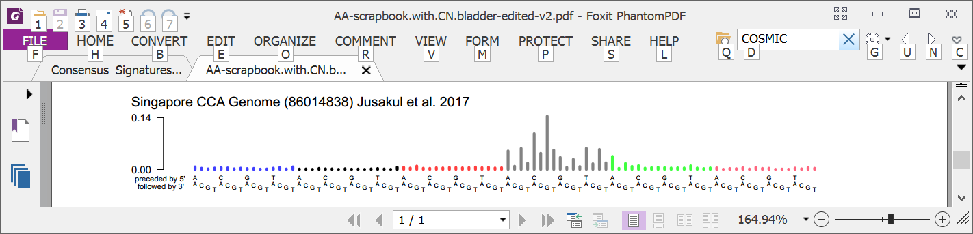
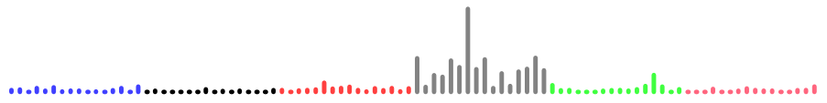
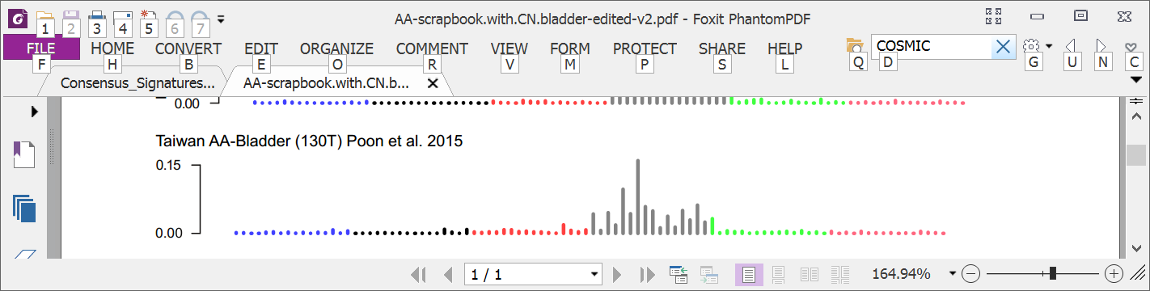
3 years ago: Mutational signatures showed AA in multiple tumor types
Liver
Bile duct
Kidney
Upper tract urothelial
Bladder
Poon et al., 2013 and subsequent data (liver - hepatocellular carcinoma [HCC])
Zou et al., 2015, Jusakul et al., 2017 (bile duct carcinoma)
Scelo et al., 2014, Jelakovic et al., 2014 (kidney/renal cell carcinoma)
Poon et al., 2013, Hoang et al., 2013, many others (upper tract urothelial carcinoma)
Poon et al., 2015, others (bladder urothelial carcinoma)

Slide 21

Taiwan a known hotspot for AA exposure but AA in liver cancer there not studied
Chen, …., Grollman, PNAS, 2012
Map created by Freepik

Slide 22
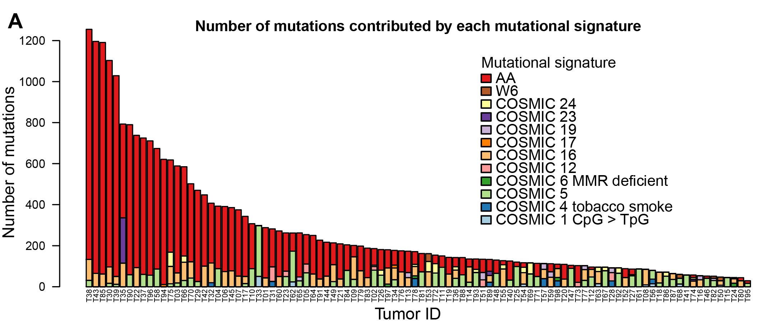
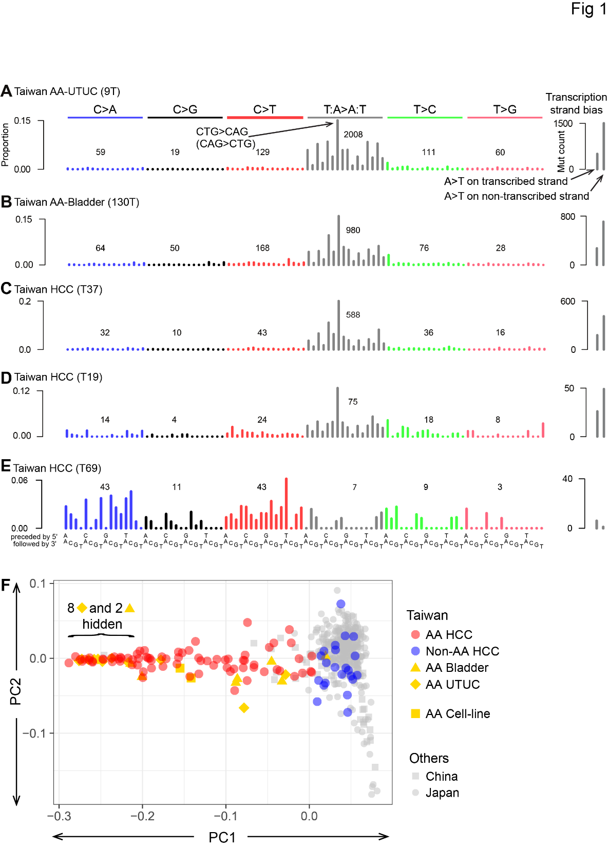
78% of Taiwan liver cancers (HCCs) had the AA signature
Ng, Poon, et al., Oct 2017 DOI: 10.1126/scitranslmed.aan6446

Slide 23
How extensive is AA exposure in > 1,600 liver cancers around the world?

Slide 24
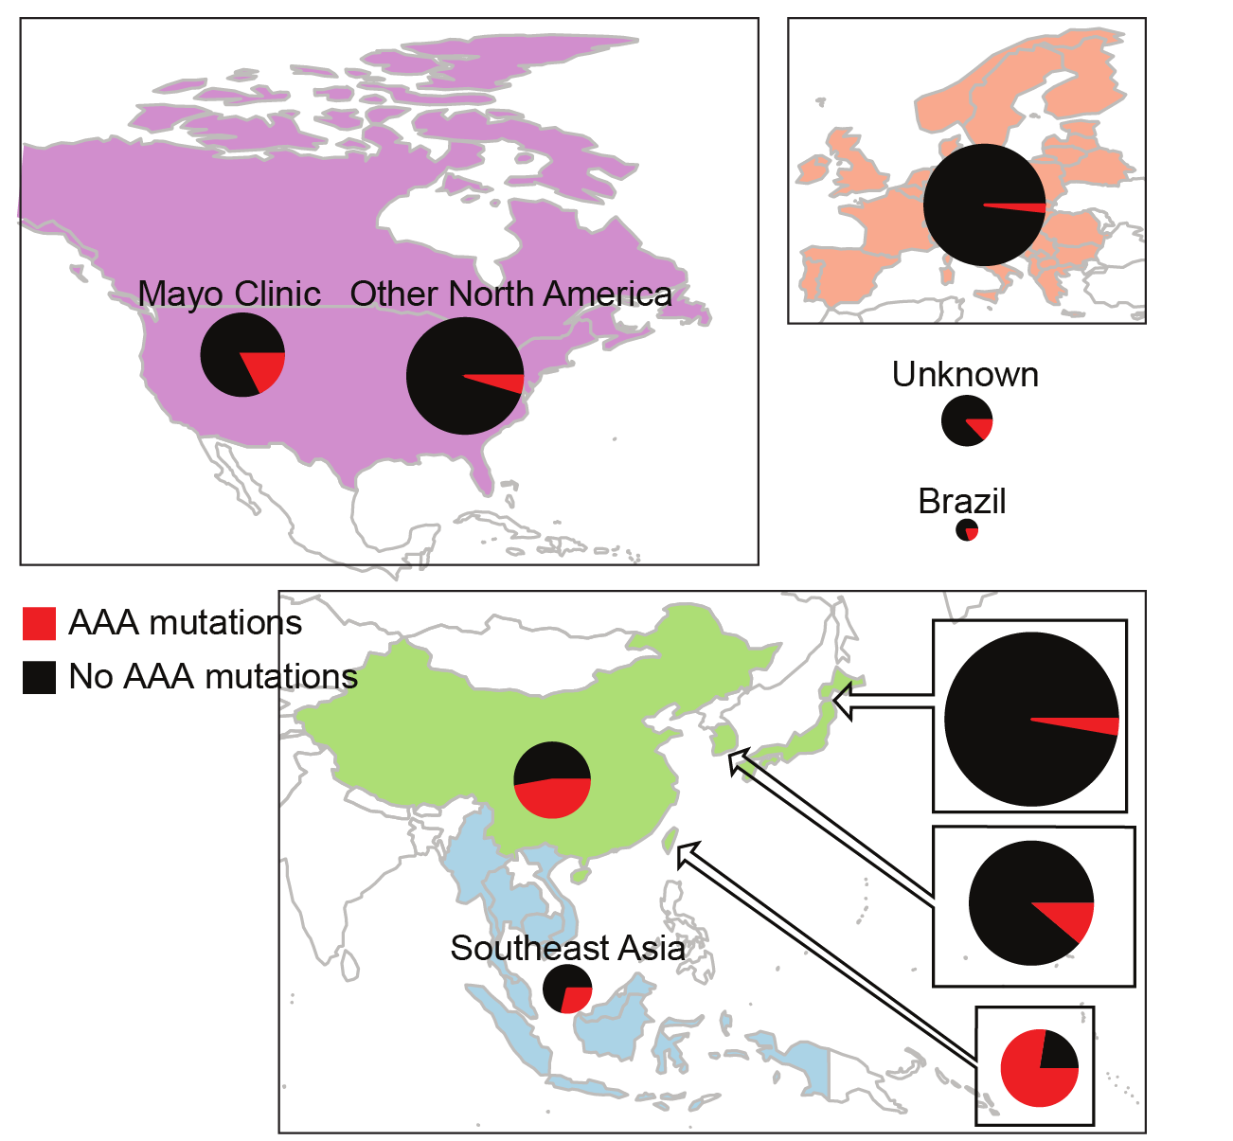
Prevalent AA exposure across > 1,600 liver cancers
“Asian” patients with no “country” – Overseas patients?
~50/100 (~50%) combined HCC and bile duct cancer in China
12/47 (25%) in Qidong (aflatoxin a major competing hazard)
Ng, Poon, et al., Oct 2017 DOI: 10.1126/stranslmed.aan6446 and subsequent publications; Zhang et al., 2017, Gastroenterology, 10.1053/j.gastro.2017.03.024; Xue et al., 2019, Cancer Cell,10.1016/j.ccell.2019.04.007

Slide 25
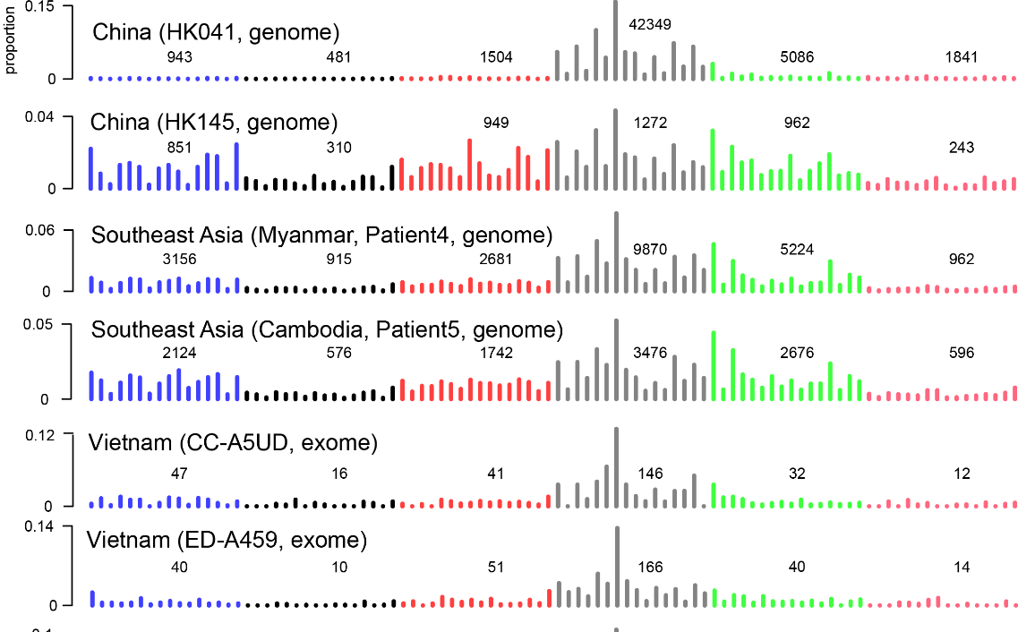

Slide 26
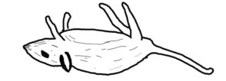
AA can cause liver cancer
Evidence…
Known mutagen and urinary tract carcinogen
“Asian” patients with no “country” – Overseas patients?
Multiple known cancer driver genes with AA mutations
Proportion of AA exposed liver cancers in Taiwan (78%) much greater than proportion of population exposed to AA herbs, (33%)
AA adducts liver tissue of HCC patients
~50/100 (~50%) combined HCC and bile duct cancer in China
Linear relationship between AA dose and risk of liver cancer in hepatitis-B-infected and hepatitis-C-infected patients
AA causes liver cancer in mice
12/47 (25%) in Qidong (aflatoxin a major competing hazard)
Ng, Poon, et al., Oct 2017 DOI: 10.1126/stranslmed.aan6446 and subsequent publications; Zhang et al., 2017, Gastroenterology, 10.1053/j.gastro.2017.03.024; Xue et al., 2019, Cancer Cell,10.1016/j.ccell.2019.04.007，Hsieh et al., 2008, 10.1186/1749-8546-3-13) Chen et al., 2018 (International Journal of Cancer, 10.1002/ijc.31544) Chen et al., 2019 (Cancer Epidemiology, Biomarkers & Prevention, 10.1158/1055-9965.EPI-19-0023），Lu et al. 2019 Hepatology, 2019, 10.1002/hep.30863 (mouse study)

Slide 27
Outline
What are mutational signatures and what are they good for?
Computational analysis of mutational signatures – state of the art
Important unsolved problems in mutational signature analysis
Summary

Slide 28
What questions do we want to answer?
“Extraction” / Discovery Given a large number of spectra, what mutational signatures are present? (I.e. mutational signatures are latent variables to be discovered.) And how many mutations are caused by each extracted signature in each spectrum? (“Attribution”)
“Attribution only” Given known mutational signatures and one or more spectra, how many mutations in each spectrum were caused by each signature?
“Signature presence test” Given known mutational signatures, what is the evidence that a signature of interest is present in a spectrum?

Slide 29

What questions do we want to answer?
“Extraction” / Discovery Given a large number of spectra, what mutational signatures are present? (I.e. mutational signatures are latent variables to be discovered.) And how many mutations are caused by each extracted signature in each spectrum? (“Attribution”)
“Attribution only” Given known mutational signatures and one or more spectra, how many mutations in each spectrum were caused by each signature?
“Signature presence test” Given known mutational signatures, what is the evidence that a signature of interest is present in a spectrum?

Slide 30
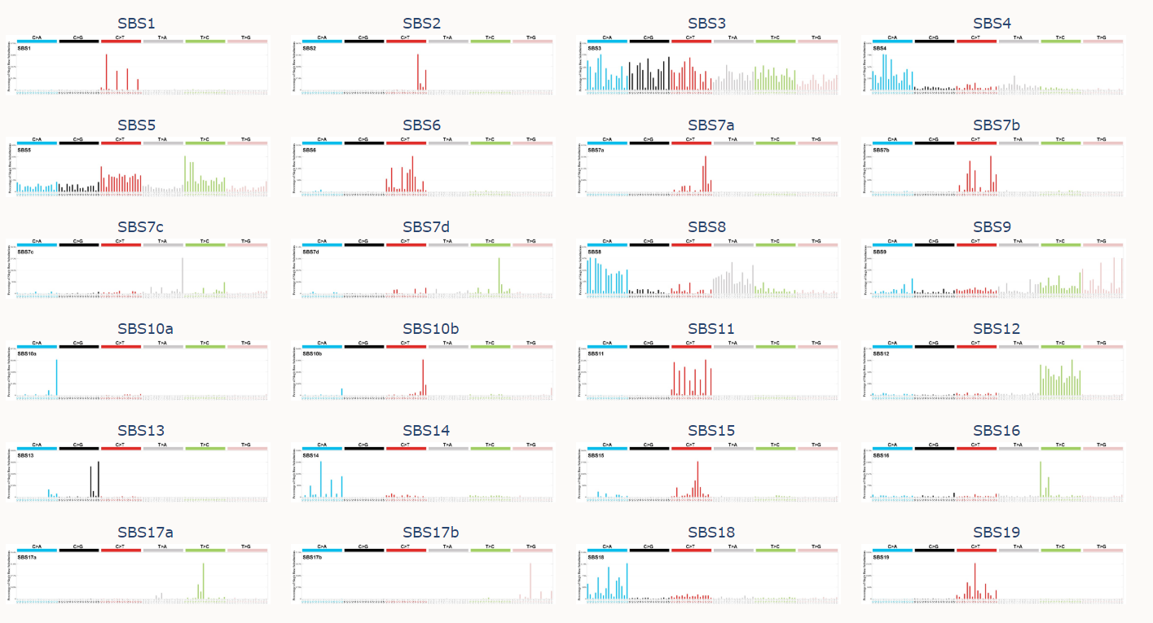
Many signatures have been extracted and many have been confirmed by additional evidence
…
and many more
https://cancer.sanger.ac.uk/cosmic/signatures/index.tt from Alexandrov, L.B., Kim, J., Haradhvala, N.J. et al. The repertoire of mutational signatures in human cancer. Nature 578, 94–101 (2020) https://doi.org/10.1038/s41586-020-1943-3

Slide 31
Sometimes a spectrum is dominated by 1 signature (Herbal medicine aristolochic acid mutations in multiple cancer types)
Liver
Bile duct
Kidney
Upper tract urothelial
Bladder
Poon et al., 2013 and subsequent data (liver - hepatocellular carcinoma [HCC])
Zou et al., 2015, Jusakul et al., 2017 (bile duct carcinoma)
Scelo et al., 2014, Jelakovic et al., 2014 (kidney/renal cell carcinoma)
Poon et al., 2013, Hoang et al., 2013, many others (upper tract urothelial carcinoma)
Poon et al., 2015, others (bladder urothelial carcinoma)

Slide 32
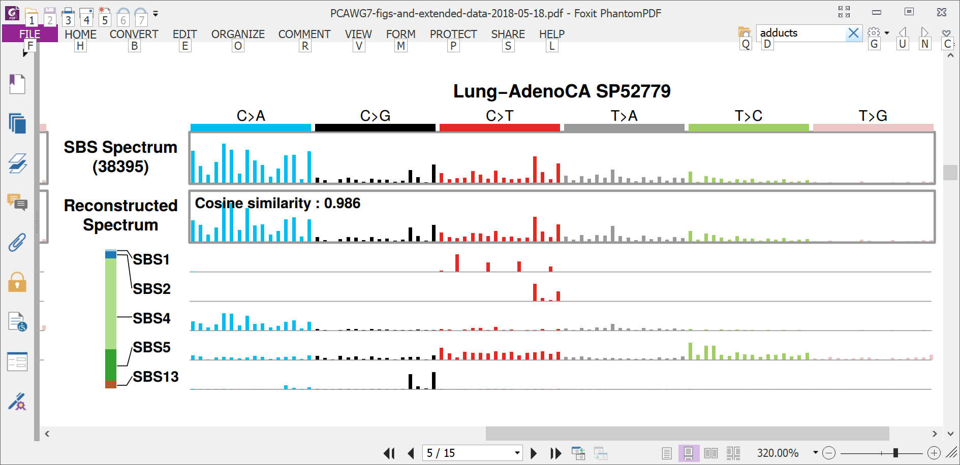
More often, spectra consist of superimposed mutations from multiple processes
Spectrum:
39,000 mutations

Slide 33
More often, spectra consist of superimposed mutations from multiple processes
Spectrum:
39,000 mutations
Counts of mutations due to 5 signatures

Slide 34
More often, spectra consist of superimposed mutations from multiple processes
Spectrum:
39,000 mutations
Counts of mutations due to 5 signatures

Slide 35
More often, spectra consist of superimposed mutations from multiple processes
Spectrum:
39,000 mutations
Counts of mutations due to 5 signatures

Slide 36
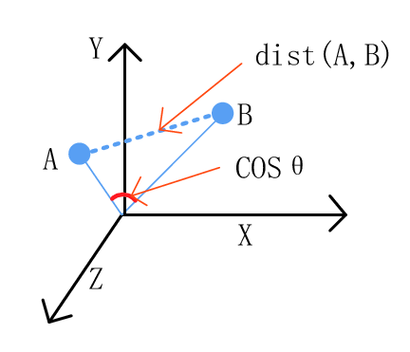
Cosine similarity versus Euclidean distance
Consider the signature to be a vector in 96-dimensional space
Figure from 10.3390/info8040140 Wang, Chen, Wu, 2017

Slide 37
Data mining can tease apart signatures in large sets of spectra
There are approaches based on:
Non-negative-factorization (NMF)
Probabilistic topic models
(will not discuss, see Nicola Roberts’ thesis https://www.repository.cam.ac.uk/handle/1810/275454 and https://github.com/steverozen/mSigHdp )
Unsupervised machine learning
All methods seem to face similar challenges
Signature discovery is not a purely algorithmic process
The granularity of extracted signatures and the type of mutations considered depend on the larger questions you are considering

Slide 38
Many techniques for extraction are based on non-negative matrix factorization (NMF)
Each cell contains level of exposure of 1 tumor to 1 signature
23,000 tumors
W
X
H
N
signatures
96 mutation types
23,000 tumors
N
signatures
≈
V (observed mutations)
96 mutation types

Slide 39
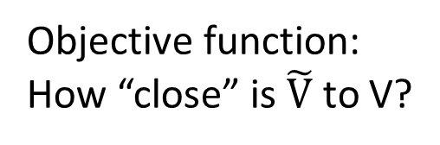

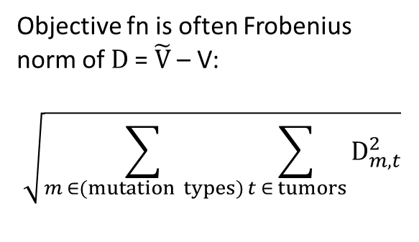
Many techniques for mutational signature extraction are based on non-negative matrix factorization (NMF)
Each cell contains level of exposure of 1 tumor to 1 signature
Objective fn is often Frobenius norm of D = $\tilde{V}$ – V:
$$\sqrt{\sum_{m ∈(mutation types)}{\sum_{t ∈ tumors}{D_{m,t}^{2}}}}$$
23,000 tumors
W
X
H
N
signatures
96 mutation types
23,000 tumors
N
signatures
=
$\tilde{V}$ = W x H
96 mutation types
Objective function:
How “close” is $\tilde{V}$ to V?
≈
V (observed mutations)

Slide 40
General observations on NMF
NMF is a collection of algorithms and techniques
The best approximate factorization depends on the objective function
As for many unsupervised learning approaches, determining the number of items (signatures) to discover is challenging
Need to avoid overfitting (so often do multiple factorizations on e.g. bootstrapped data)

Slide 41
NMF example: SigProfilerExtractor
Supersedes the MATLAB code used in Alexandrov 2013 and 2020
Latest release: https://pypi.org/project/sigproextractor/
https://github.com/AlexandrovLab
Documentation at https://osf.io/t6j7u/wiki/3.%20Using%20the%20Tool%20-%20Output/
More info in Alexandrov et al 2013 and 2020:
http://dx.doi.org/10.1016/j.celrep.2012.12.008
https://doi.org/10.1038/s41586-020-1943-3

Slide 42
SigProfilerExtractor runs NMFs over multiple iterations of bootstrapped data
Purpose, to avoid overfitting
Multinomial resampling of counts for mutation types (e.g. ACA > AAA, ACC > AAC, … TTT > TGT) for each tumor based on the observed total mutation count in the tumor and the proportion of counts of each mutation type.
Recommends 100; user smaller number for initial testing
Recommend to run several times with different seeds; if solutions are different, run more NMF iterations
More info in Alexandrov et al 2013 and 2020:
http://dx.doi.org/10.1016/j.celrep.2012.12.008
https://doi.org/10.1038/s41586-020-1943-3

Slide 43
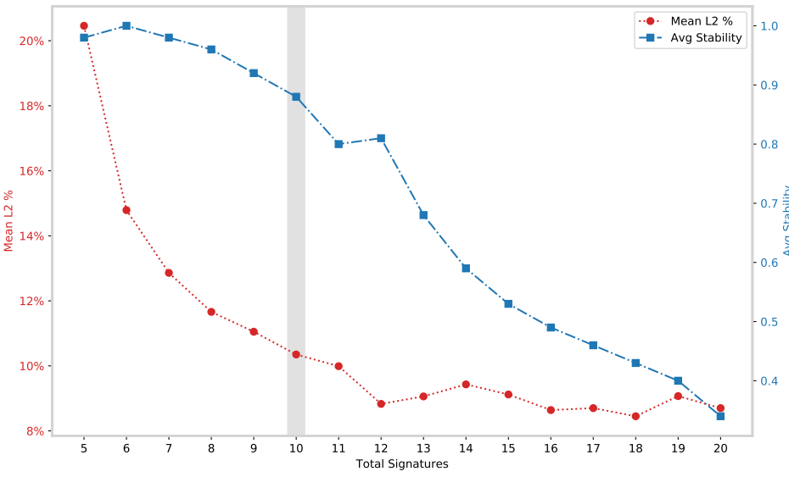
SigProfilerExtractor: Selecting the number of signatures
Mean L2% is the average across samples of the percent Euclidian reconstruction error (low is good)
Average stability is the mean across NMF iterations of silhouette coefficient of the clusters of proto-signatures (indicates how well the proto-signatures are clustered into signatures – high is good)

Slide 44
Known issues with approaches based on non-negative matrix factorization (NMF)
The number of signatures is a judgement call (some approaches deal with this)
Weak signatures cannot be discovered in background of strong signatures
Signatures can be imperfectly separated (“bleeding” and “stealing” between signatures)
More generally, recovered signatures depend strongly on exact set of tumours studied
Lowest error reconstruction often involves many signatures, some with very low contributions, and often not biologically plausible (see following slides)
Signature discovery (extraction) is not a purely algorithmic process
In practice, discovering signatures (“extraction”) needs to be separated from estimating exposures (“attribution”)
!

Slide 45
Sparsity and plausibility
Signatures that, when combined, give the most accurate reconstruction of a spectrum are the best ones
Adding more signatures in tiny amounts usually improves reconstruction even if activity of signatures is biologically implausible
Not useful for deciding if a mutational signature is present to a biologically meaningful extent

Slide 46
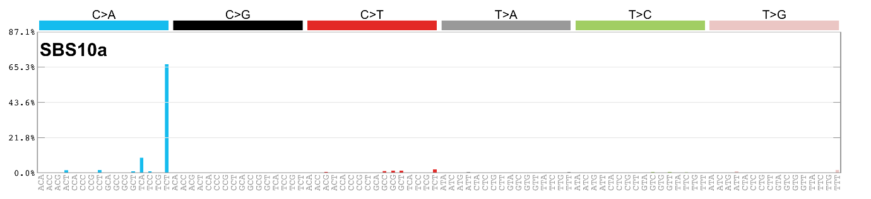
Extreme example:
A set of 96 signatures, each of one single base substitution in trinucleotide context will yield perfect reconstruction and zero biological insight

Slide 47
Signature discovery is not a purely algorithmic process: How to assess results (1)
The input data have been examined for sequencing and mapping artifacts (some which are well-known); mapped reads supporting unusual patterns have been examined in a read-alignment viewer or have been experimentally verified
Look for external supporting evidence
Correlation with known or expected mutagenic exposures, eg
cigarette smoking
Aflatoxins
AA-containing herbs
Haloalkanes
Age
UV radiation
Correlation with known or expected genetic causes, eg
polymerase epsilon proofreading defects
mismatch repair deficiency
homologous recombination repair deficiency (BRCA)
Can be tied to known biochemical processes (eg guanine adducts and signatures with C:G > N:N mutations)

Slide 48
Signature discovery is not a purely algorithmic process: How to assess results (2)
Association with genomic features that interact with DNA repair
Transcription strand bias
Replication strand / timing
Homopolymers (indels)
Look for supporting evidence within the data set
Samples dominated by a single signature
Signature is consistently deciphered from multiple independent datasets using different techniques or hyperparameters
Absence of known problems (next slides)
More info at https://static-content.springer.com/esm/art%3A10.1038%2Fs41586-020-1943-3/MediaObjects/41586_2020_1943_MOESM4_ESM.pdf, pages 6 & 7
Look for known issues with signature discovery

Slide 49
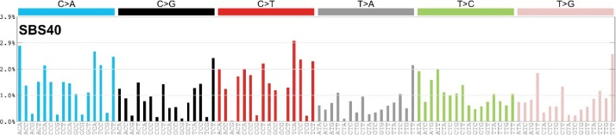
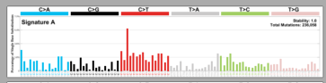
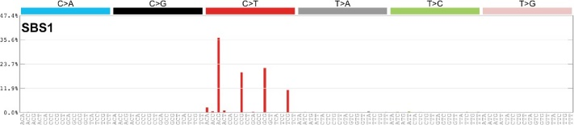
Known problems: bleeding
Ground truth (synthetic data)
Extracted
“Bleeding” or incomplete separation of some CG > TG mutations from SBS1 to SBS40-like extracted signature
49

Slide 50
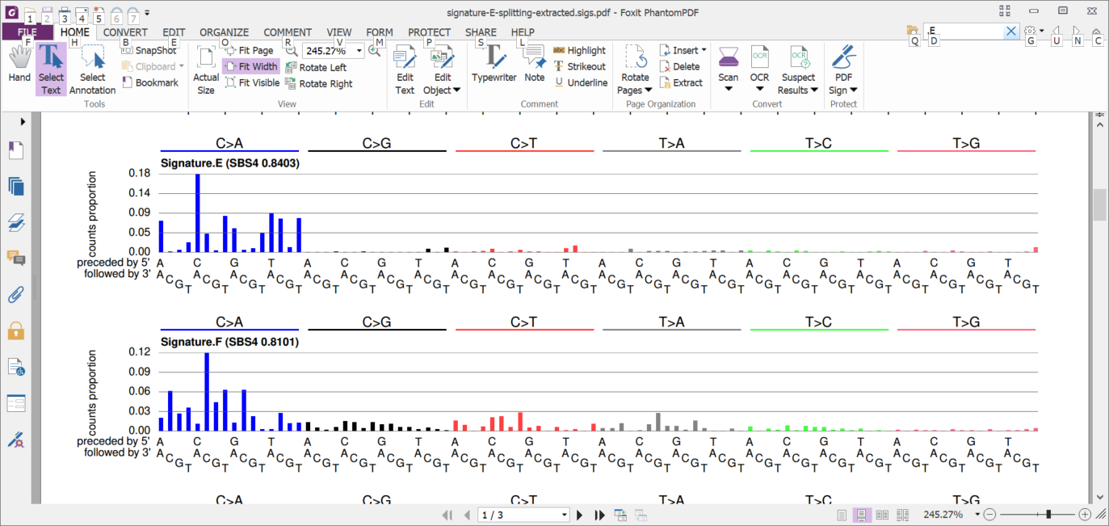
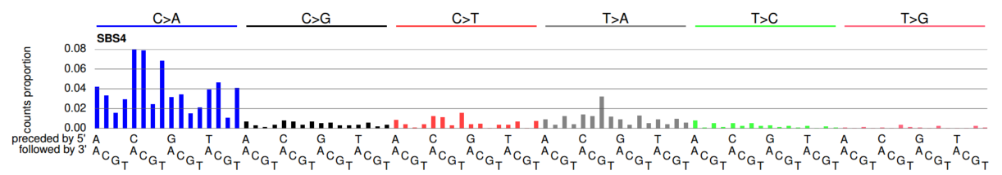
Known problem: over-splitting (from a different synthetic data set)
+
2 extracted signatures
≈
1 ground-truth signature

Slide 51
Outline
What are mutational signatures and what are they good for?
Computational analysis of mutational signatures – state of the art
Important unsolved problems in mutational signature analysis
Summary

Slide 52
What questions do we want to answer?
“Extraction” / Discovery Given a large number of spectra, what mutational signatures are present? (I.e. mutational signatures are latent variables to be discovered.) And how many mutations are caused by each extracted signature in each spectrum? (“Attribution”)
“Attribution only” Given known mutational signatures and one or more spectra, how many mutations in each spectrum were caused by each signature?
“Signature presence test” Given known mutational signatures, what is the evidence that a signature of interest is present in a spectrum?

Slide 53
What questions do we want to answer?
“Extraction” / Discovery Given a large number of spectra, what mutational signatures are present? (I.e. mutational signatures are latent variables to be discovered.) And how many mutations are caused by each extracted signature in each spectrum? (“Attribution”)
“Attribution only” Given known mutational signatures and one or more spectra, how many mutations in each spectrum were caused by each signature?
“Signature presence test” Given known mutational signatures, what is the evidence that a signature of interest is present in a spectrum?

Slide 54
General issues with attribution
Not studied very thoroughly
With enough signatures, adding more signatures almost always improves reconstructions
Issues of sparsity (tiny exposures to many signatures)
Issues of biological plausibility
Common examples:
ultraviolet signatures in tumors with no possibility of UV exposure
Single base substitution signatures of microsatellite instability in tumors that clearly do not have microsatellite instability
Signatures of defective polymerase epsilon proofreading (which generates very high numbers of mutations) with very low mutation counts (and no defect in the polymerase epsilon gene).

Slide 55
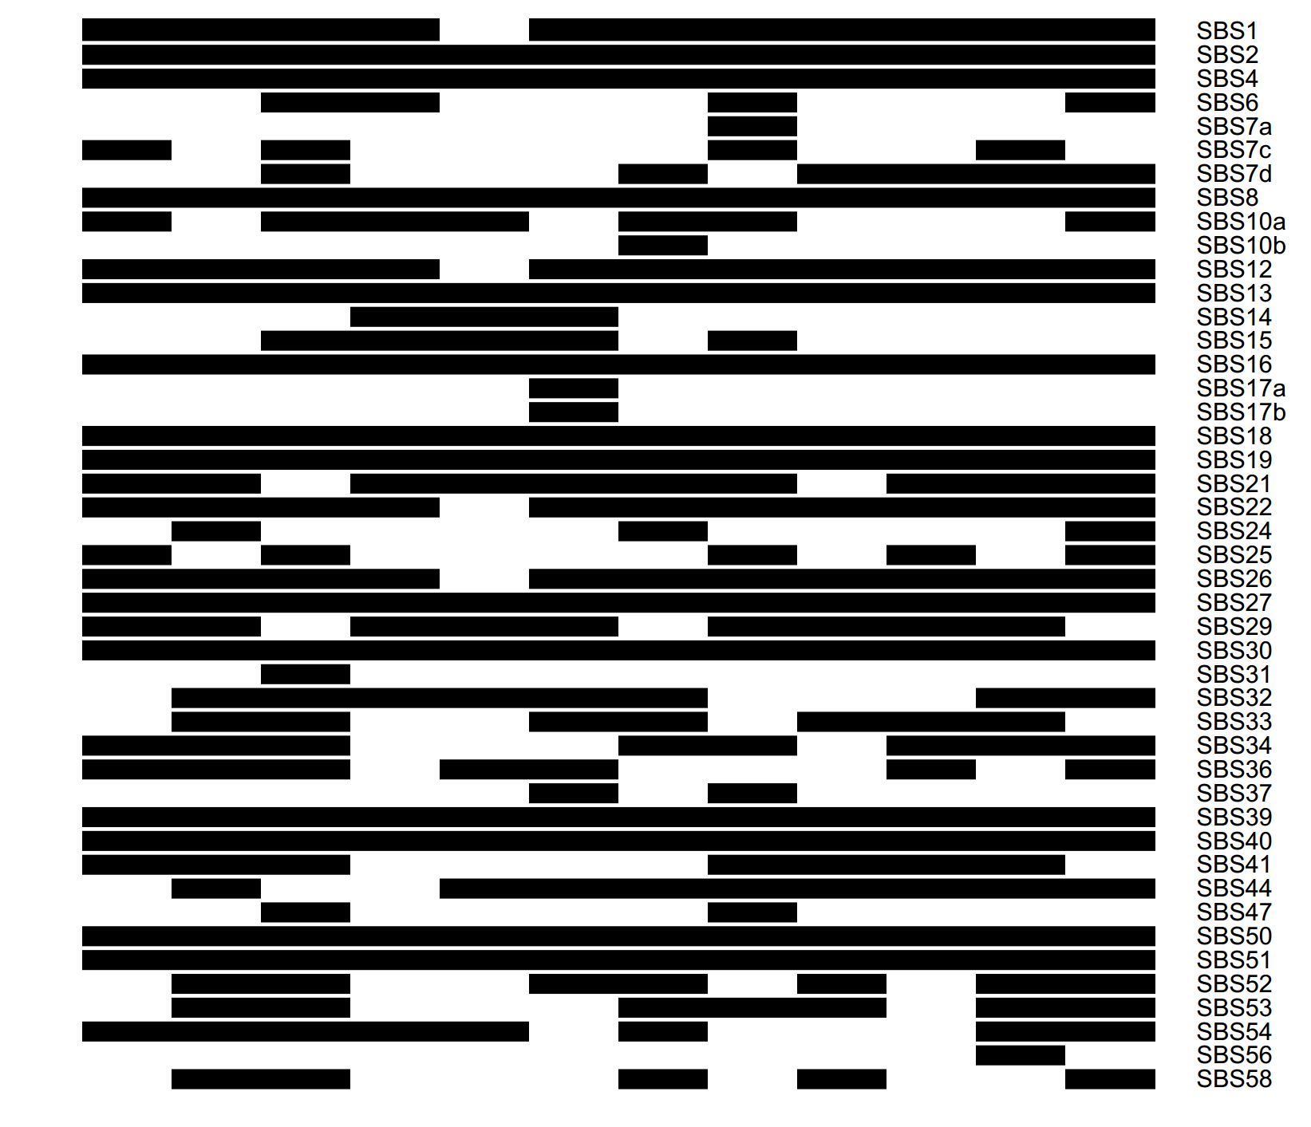
Example: several lung cancers (squamous) We simply optimized coefficients of all known signatures to minimize reconstruction error (45 signatures assigned) Good reconstructions but bad models of reality (Signatures from Alexandrov, L.B., Kim, J., Haradhvala, N.J. et al. The repertoire of mutational signatures in human cancer. Nature 578, 94–101 (2020). https://doi.org/10.1038/s41586-020-1943-3)
. . .
Black indicates signature present
Tumor 1
Tumor 2
Signature

Slide 56
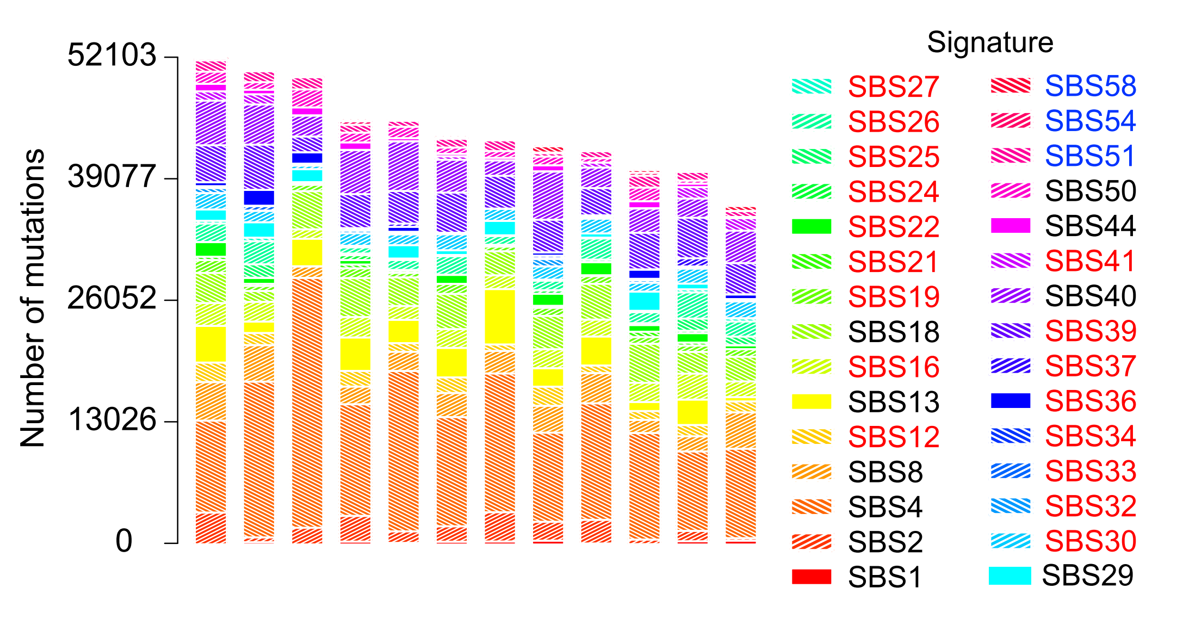
Impose some sparsity by requiring minimum number of mutations (30 signatures assigned) Still a good reconstruction but a bad model of reality
SBS50

Slide 57
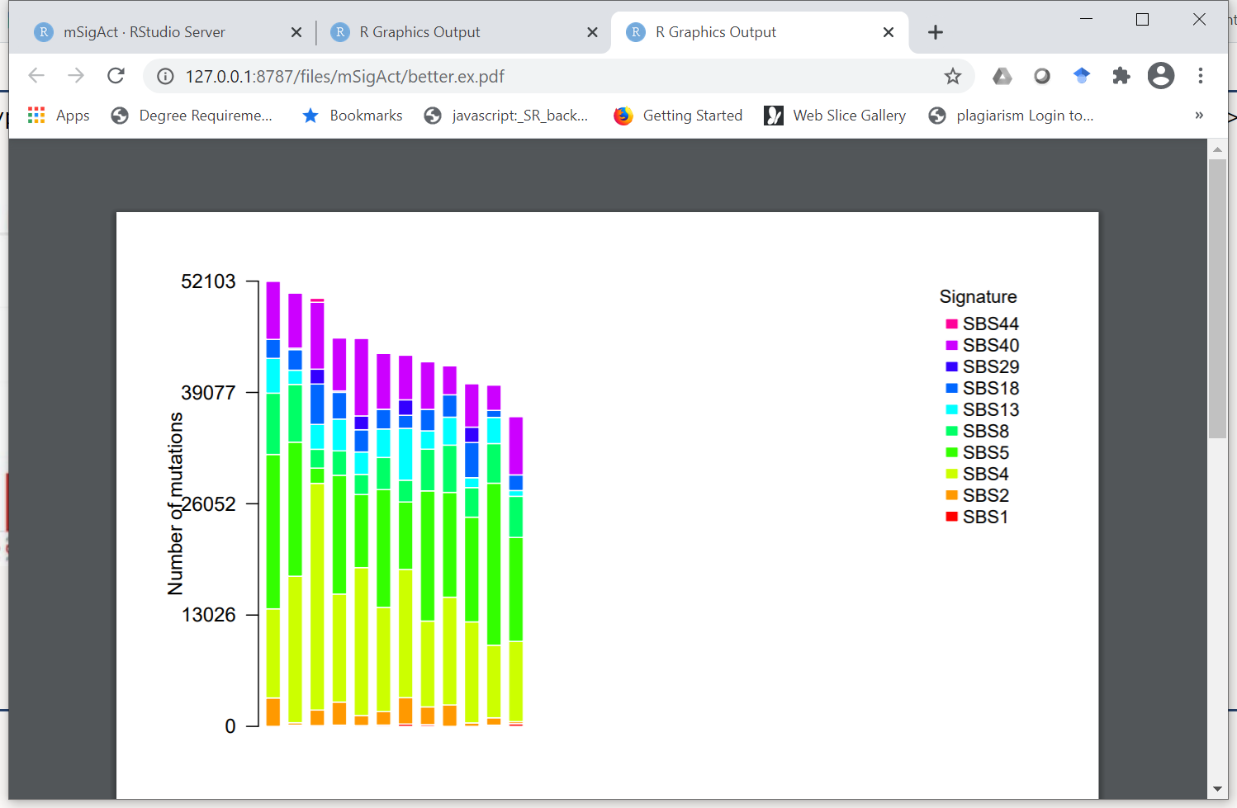
Considering only mutations found in lung cancer (squamous) Much better

Slide 58
Considering only mutations found in lung cancer (squamous) Much better
But these signatures are very rare in this cancer type

Slide 59
What questions do we want to answer?
D
“Extraction” / Discovery Given a large number of spectra, what mutational signatures are present? (I.e. mutational signatures are latent variables to be discovered.) And how many mutations are caused by each extracted signature in each spectrum? (“Attribution”)
“Attribution only” Given known mutational signatures and one or more spectra, how many mutations in each spectrum were caused by each signature?
“Signature presence test” Given known mutational signatures, what is the evidence that a signature of interest is present in a spectrum?
Detour

Slide 60
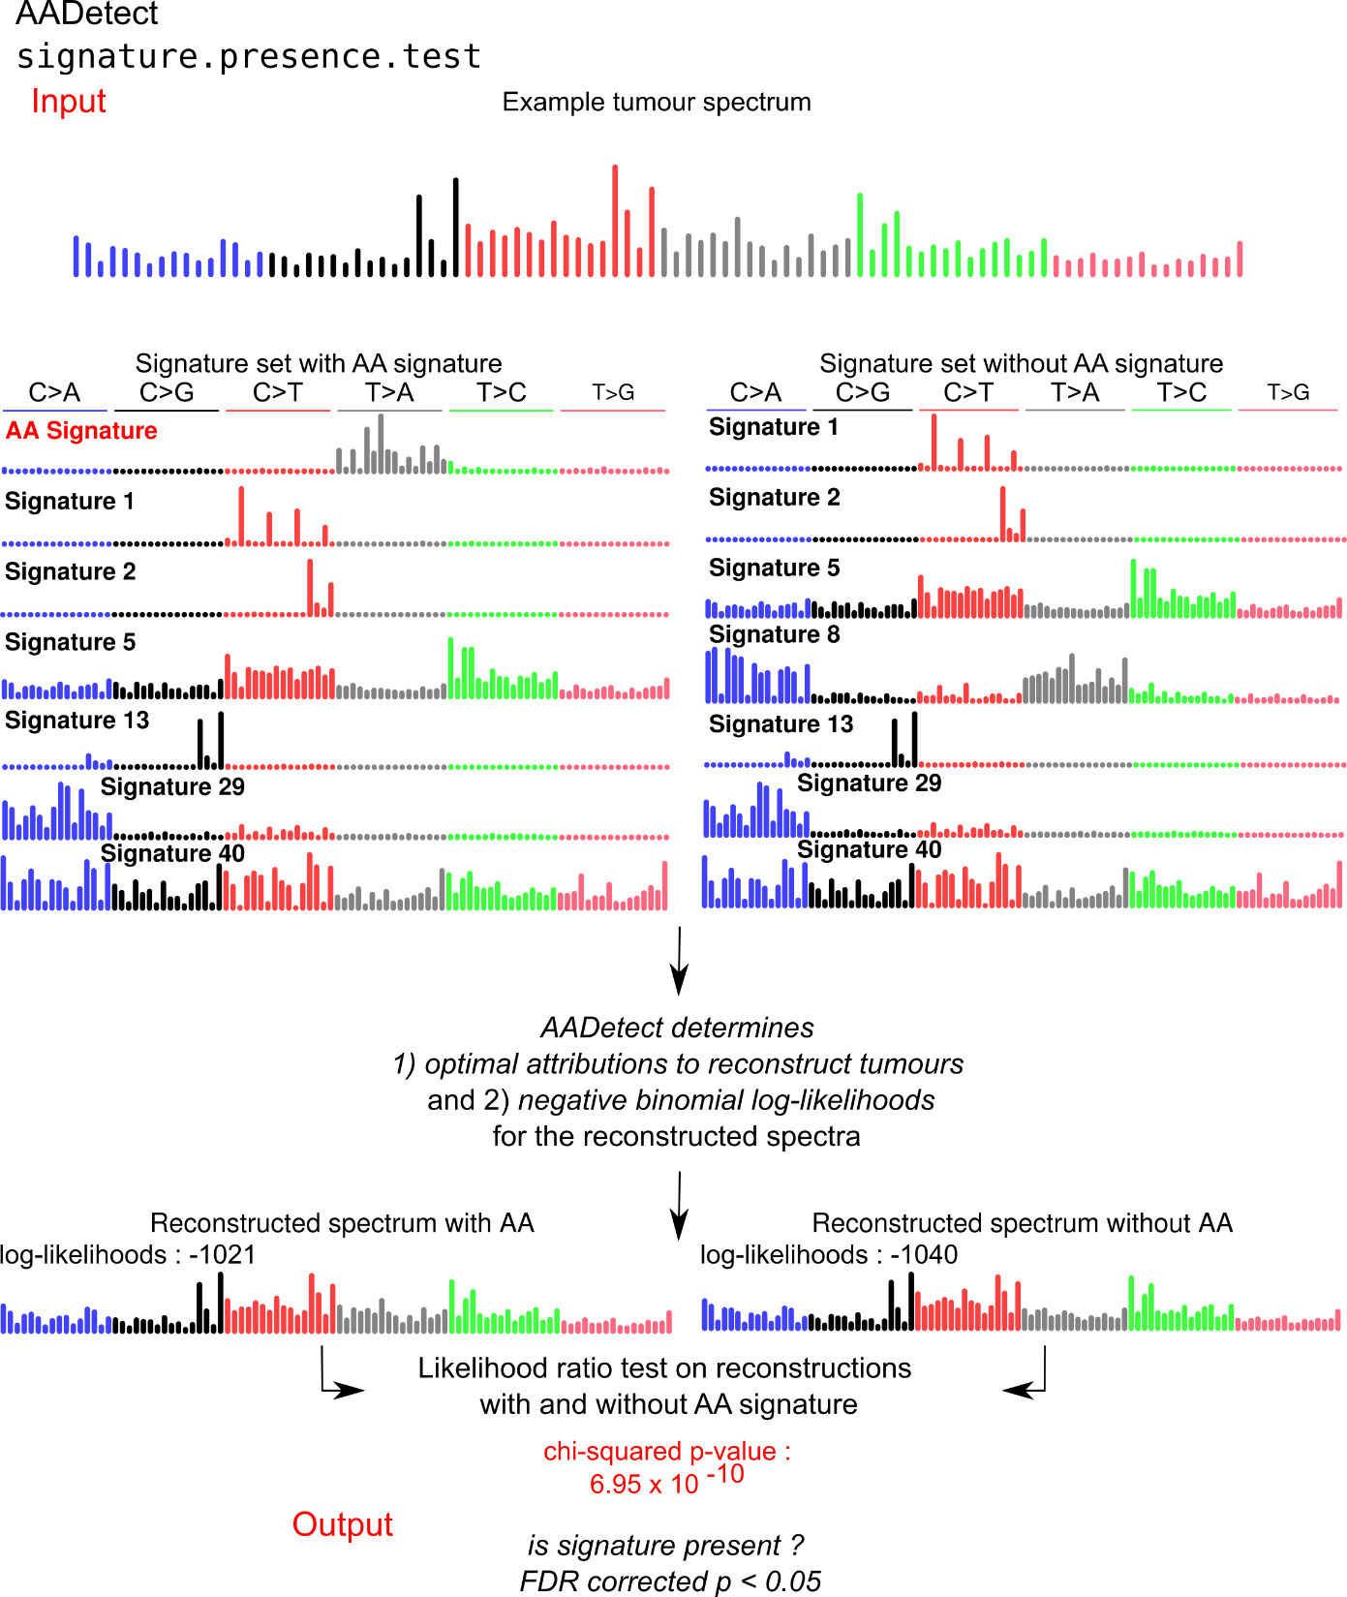
Signature presence test
?
Is the AA signature present?
Example, motivated by our study of AA exposure in liver cancer
Was this tumour exposed to AA?

Slide 61
Signature presence test
Best reconstruction without AA
Log likelihood of reconstruction -1040

Slide 62
Signature presence test
Best reconstruction without AA
The likelihood of the reconstruction is the probability that negative binomial resampling from the reconstruction yields the spectrum
Log likelihood of reconstruction -1040

Slide 63
Signature presence test
Best reconstruction WITH AA
Best reconstruction without AA
Log likelihood of reconstruction -1021
Log likelihood of reconstruction -1040

Slide 64
Signature presence test
Best reconstruction WITH AA
Best reconstruction without AA
Likelihood ratio test
p < 10⁻⁹
Note that we have added a statistical concept
Log likelihood of reconstruction -1021
Log likelihood of reconstruction -1040

Slide 65
We reject the null hypothesis that the reconstruction of the spectrum without the AA signature is as good as the reconstruction with the AA signature That is, we need the AA signature to plausibly explain the spectrum

Slide 66
Can extend the signature presence test to sets of signatures “Is this set of signatures needed to plausibly account for this spectrum?”

Slide 67
This means we can find all subsets of signatures that can plausibly account for a spectrum (usually more than one such subset)

Slide 68
We can then search among subsets of signatures that can plausibly explain the spectrum to find the “best” subset

Slide 69
Example of multiple plausible reconstructions
One squamous lung cancer
Possible signatures SBS1, SBS2, SBS4, SBS5, SBS8, SBS13, SBS18, SBS29, SBS40, SBS44
Can remove ~60 subsets of signatures and still get plausible reconstruction
For example, can remove
SBS29
SBS18, SBS29
SBS18, SBS29, SBS40, SBS44,
SBS1, SBS18, SBS29, SBS40, SBS44

Slide 70
What questions do we want to answer?
“Extraction” / Discovery Given a large number of spectra, what mutational signatures are present? (I.e. mutational signatures are latent variables to be discovered.) And how many mutations are caused by each extracted signature in each spectrum? (“Attribution”)
“Attribution only” Given known mutational signatures and one or more spectra, how many mutations in each spectrum were caused by each signature?
“Signature presence test” Given known mutational signatures, what is the evidence that a signature of interest is present in a spectrum?

Slide 71
Considering only mutations found in lung cancer (squamous) Much better
But these signatures are very rare in this cancer type

Slide 72
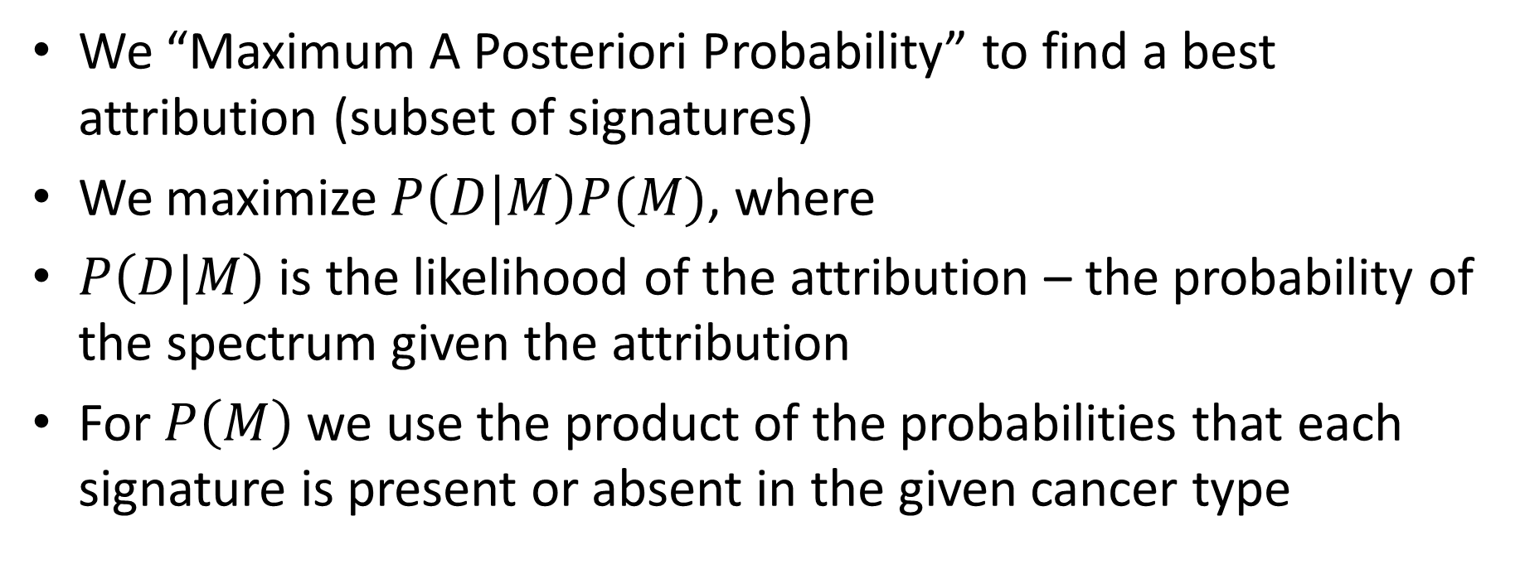
A notion of the “best” subset among the subsets that can plausibly explain the spectrum
We “Maximum A Posteriori Probability” to find a best attribution (subset of signatures)
We maximize $P\left(D | M\right)P(M)$, where
$P\left(D | M\right)$ is the likelihood of the attribution – the probability of the spectrum given the attribution
For $P\left(M\right)$ we use the product of the probabilities that each signature is present or absent in the given cancer type

Slide 73

Very rare signatures in squamous cell lung cancer (SBS18, SBS29, SBS44) no longer attributed SBS40 (found in 5% of squamous lung cancer) probably needs more investigation

Slide 74
Outline
What are mutational signatures and what are they good for?
Computational analysis of mutational signatures – state of the art
Important unsolved problems in mutational signature analysis
Summary

Slide 75
Summary
In the overview…
Explained the concepts of mutational signatures
Gave an example of mutational signatures in molecular epidemiology: mutational signatures revealed the role of AA – aristolochic acid – in causing liver cancer and other cancers

Slide 76
Prevalent AA exposure across > 1,600 liver cancers
“Asian” patients with no “country” – Overseas patients?
~50/100 (~50%) combined HCC and bile duct cancer in China
12/47 (25%) in Qidong (aflatoxin a major competing hazard)
Ng, Poon, et al., Oct 2017 DOI: 10.1126/stranslmed.aan6446 and subsequent publications; Zhang et al., 2017, Gastroenterology, 10.1053/j.gastro.2017.03.024; Xue et al., 2019, Cancer Cell,10.1016/j.ccell.2019.04.007

Slide 77
Summary: What questions do we want to answer?
Extraction (Discovery) of new signatures
Discussed approaches based on NMF (and mentioned but did not discuss approaches based on probabilistic topic models)
Discussed challenges (including deciding on the number of signatures) and pitfalls and the fact that discovering signatures is not a purely algorithm process
Attribution of known signatures
Looked at issues of sparsity
Observed that often many attributions can plausibly reconstruct a given spectrum
Which suggested that we need to formally and informally incorporate prior knowledge
Tried to capture some of this prior knowledge using by evaluating the set of plausible attributions using maximum a posteriori probability estimates
Signature presence tests
Use a likelihood ratio test to decide if a particular signature or set of signatures is plausibly required to reconstruct an observed spectrum

Slide 78
Acknowledgements for AA in Liver Cancer
Chang Gung Memorial Hospital
Sen-Yung Hsieh (谢森永)
Hao-Yi Huang
Ming-Chin Yu
Po-Huang Lee
Jacob See-Tong Pang
Singapore (Duke NUS, National Cancer Centre Singapore, and Johns Hopkins Singapore)
Arnoud Boot
Alvin NG Wei Tian (黄伟添)
Song Ling POON
Mi Ni HUANG
Jing Quan LIM
Nanhai Jiang
Shenli Zhang
Szu-Chi Ho
Willie Yu
Yuka Suzuki
Cedric C. Y. Ng
Patrick Tan
Bin Tean TEH
Alex Chang
Funding
Singapore National Medical Research Council
Singapore Ministry of Health via the Duke-NUS Signature Research Programmes
Chang Gung Medical Foundation
https://tinyurl.com/aa-liver-cancer

Slide 79
General acknowledgements
The International Cancer Genome and The Cancer Genome Atlas Pan-Cancer Analysis of Whole Genomes Consortium (PCAWG)
The PCAWG Mutational Signatures Analysis Working Group
Co-lead Mike Stratton, many contributors including Ludmil Alexandrov, Jaegil Kim, Gaddy Getz, Nick Haradhvala, and many many others, see https://doi.org/10.1038/s41586-020-1943-3
My lab
Arnoud Boot, Szu-Chi HO, Mini Huang, Nanhai Jiang, John McPherson, LIU Mo, Alvin Wei Tian Ng, WU Yang, Willie Yu, Shenli Zhang

Slide 80

Caution: Conceptual Hazard These analytical tools are not oracles They do not algorithmically reveal a Platonic truth Their analyses need to be assessed by humans in the light of all available evidence

Slide 81
“All models are wrong but some are useful”
George E. P. Box (1979), "Robustness in the strategy of scientific model building", in Launer & Wilkinson, Robustness in Statistics
I hope you will find some of these models useful
More research is needed!
Thank you and questions?
steverozen@gmail.com
81

Slide 82
Backup Slides

Slide 83

M. Heinrich et al 2009
doi:10.1016/j.jep.2009.05.028

Slide 84


AA causes liver cancer in mice
** or * indicate
significant
versus untreated
The mutational features of aristolochic acid-induced mouse and human liver cancers
Zhao-Ning Lu, Qing Luo, Li-Nan Zhao, Yi Shi, Xian-Bin Su,
Ze-Guang Han
doi: https://doi.org/10.1101/507301
Dec 28, 2018
Months after exposure
7.5 15 35 70
Total dose (mg/kg)
(Re-drawn from Lu et al.)

